Slide 1

Kubernetes Controllers 101
By Chetan Shah

Slide 2
Kubernetes Workload Resources

Slide 3
Kubernetes Workload Resources
Deployment
Replicaset
StatefulSet
DaemonSet
Job
CronJob
Garbage Collection

Slide 4
Kubernetes - Deployment
You describe a desired state in a Deployment, and the Deployment Controller changes the actual state to the desired state at a controlled rate.
You can define Deployments to create new ReplicaSets, or to remove existing Deployments and adopt all their resources with new Deployments.
https://kubernetes.io/docs/concepts/workloads/controllers/deployment/

Slide 5
Kubernetes - ReplicaSet
A ReplicaSet's purpose is to maintain a stable set of replica Pods running at any given time.
It is used to guarantee the availability of a specified number of identical Pods.
https://kubernetes.io/docs/concepts/workloads/controllers/replicaset/

Slide 6
Kubernetes - StatefulSet
Manages the deployment and scaling of a set of Pods, and provides guarantees about the ordering and uniqueness of these Pods.
StatefulSets manage stateful applications.
StatefulSet manages Pods that are based on an identical container spec.
A StatefulSet maintains a sticky identity for each of their Pods. These pods are created from the same spec, but are not interchangeable: each has a persistent identifier that it maintains across any rescheduling.
https://kubernetes.io/docs/concepts/workloads/controllers/statefulset/

Slide 7
Kubernetes - DaemonSet
A DaemonSet ensures that all (or some) Nodes run a copy of a Pod. As nodes are added to the cluster, Pods are added to them. As nodes are removed from the cluster, those Pods are garbage collected. Deleting a DaemonSet will clean up the Pods it created.
https://kubernetes.io/docs/concepts/workloads/controllers/daemonset/

Slide 8
Kubernetes - Job
A Job creates one or more Pods and will continue to retry execution of the Pods until a specified number of them successfully terminate. As pods successfully complete, the Job tracks the successful completions. When a specified number of successful completions is reached, the task (ie, Job) is complete. Deleting a Job will clean up the Pods it created. Suspending a Job will delete its active Pods until the Job is resumed again.
https://kubernetes.io/docs/concepts/workloads/controllers/job/

Slide 9
Kubernetes - CronJob
A CronJob creates Jobs on a repeating schedule.
One CronJob object is like one line of a crontab (cron table) file. It runs a job periodically on a given schedule, written in Cron format.
CronJobs are useful for creating periodic and recurring tasks, like running backups or sending emails. CronJobs can also schedule individual tasks for a specific time, such as scheduling a Job for when your cluster is likely to be idle.
https://kubernetes.io/docs/concepts/workloads/controllers/cron-jobs/

Slide 10
Kubernetes - Garbage Collector
The role of the Kubernetes garbage collector is to delete certain objects that once had an owner, but no longer have an owner.
Some Kubernetes objects are owners of other objects. For example, a ReplicaSet is the owner of a set of Pods. The owned objects are called dependents of the owner object. Every dependent object has a metadata.ownerReferences field that points to the owning object.
https://kubernetes.io/docs/concepts/workloads/controllers/garbage-collection/

Slide 11
Kubernetes - TTL Controller for Finished Resources
BETA feature
The TTL controller provides a TTL (time to live) mechanism to limit the lifetime of resource objects that have finished execution. TTL controller only handles Jobs for now, and may be expanded to handle other resources that will finish execution, such as Pods and custom resources.

Slide 12
Kubernetes Controllers

Slide 13
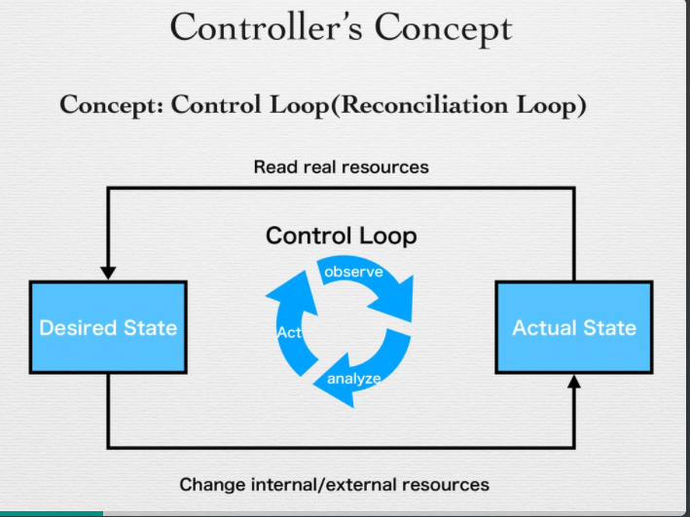
Kubernetes - Controller - The Control Loop
Controller

Slide 14
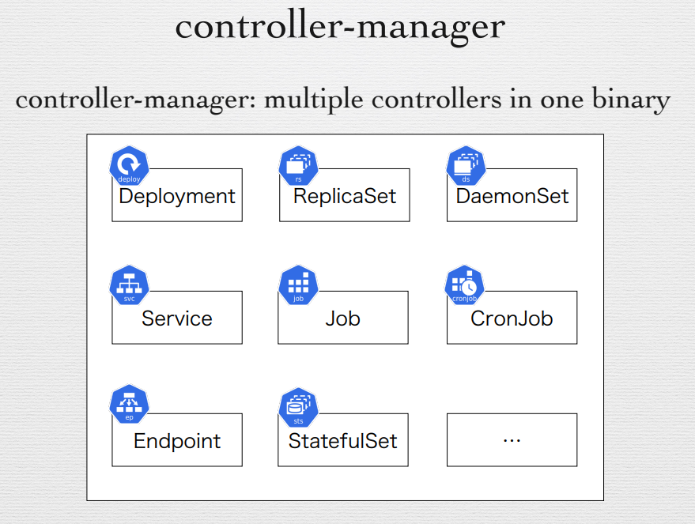
Kubernetes - Controller

Slide 15
Kubernetes - Operators
A Kubernetes operator is an application-specific controller that extends the functionality of the Kubernetes API to create, configure, and manage instances of complex applications on behalf of a Kubernetes user.
Reference Material for Advanced topic:
https://www.redhat.com/en/topics/containers/what-is-a-kubernetes-operator
https://medium.com/@victorpaulo/from-zero-to-kubernetes-operator-dd06436b9d89

